Slide 1

COMP 520 - Compilers
Lecture 21 – LLVM, JIT Compilers

Slide 2
Announcements
Please do course evaluations!
Final Exam is 5/9 at 4:00pm
The exam is written to be taken in 90 minutes, but I’m going to give you the full 180 minutes should you desire it.
COMP 520: Compilers – S. Ali

Slide 3
COMP-750
I recommend this class, but keep in mind, COMP-750 assumes you are taking at most one other class.
Very difficult class even if you are only taking one other.
COMP 520: Compilers – S. Ali

Slide 4
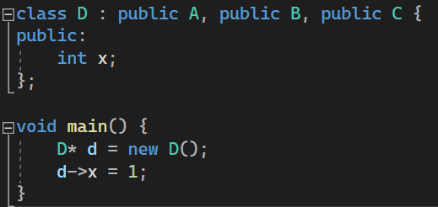
Interesting ID Errors
Can access only the top-most class’s variables when multiple inherited fields use the same variable.
Assume A, B, C all contain public: int x;
COMP 520: Compilers – S. Ali

Slide 5
Virtual Address Table vs VAT Pointer
Either works, but the primary difference is two memory deference operations vs one
This memory dereference is already very slow. Turns out the reason is because the method address is a location in the code section, but the VAT will be in the heap, so you go to the heap to eventually load code in two possibly very different locations.
With a VAT pointer, you might have two different cache lines for the VAT pointer and the VAT itself.
Can cause cache interference galore!
COMP 520: Compilers – S. Ali

Slide 6
PA4 Overview
COMP 520: Compilers – S. Ali

Slide 7
LocalDecl- ParameterDecl & VarDecl
ParameterDecl
VarDecl
x | [return addr] | Old RBP | Local var1 | Local var2
RBP+16
RSP+32
RBP+8
RSP+24
RBP
RSP+16
RBP-8
RSP+8
RBP-16
RSP
COMP 520: Compilers – S. Ali

Slide 8
FieldDecl- non-static
Some Variable’s value is a heap address
var1 | var2 | var3 | var4 | …
Object
Base
+8
+16
+24
+32
COMP 520: Compilers – S. Ali

Slide 9
MethodDecl
push rbp
mov rbp,rsp
mov rsp,rbp
pop rbp
Start off with a stack frame
End with removing the stack frame
If it is the main method, then…
  Consider static vars on the stack
  End with a sys_exit
COMP 520: Compilers – S. Ali

Slide 10
Variable Access
If the variable has a LocalDecl (parameter or VarDecl)
  Access the variable from [rbp+VD.offset]
If the variable has a FieldDecl:
  If it is static, then access however you access static variables
  Otherwise, the FieldDecl has an object offset, and access it from some context point (base address in the heap)
COMP 520: Compilers – S. Ali

Slide 11
QRef
If it is static, access static variable, otherwise…
Visit the LHS to get the heap address, and once again, the RHS is a FieldDecl and has an objOffset, so we can access the variable as normal
COMP 520: Compilers – S. Ali

Slide 12
Just-in-time Compilers
COMP 520: Compilers – S. Ali

Slide 13
JIT Compilation
Idea:
  Partially compile parts of a program
  Compile more of the program as needed
  A mix of runtime states:
    Can be running the program normally
    Program may return to a “higher-level” runtime where it returns control to the JIT compiler
COMP 520: Compilers – S. Ali

Slide 14
Step 1: Compile a part of the code
Code
Part
IL
Code
Part
x64
Accept:
Output:
IL x64
Language
x64
User
(x64)
COMP 520: Compilers – S. Ali

Slide 15
Step 2: On-demand (JIT) compile new code
New Code
IL
New Code
x64
Accomplished via a Merge Process
Existing Binary
x64
New Code
x64
Existing Binary
x64
New Binary
x64
Accept:
Output:
IL x64
Compiler
Language
User
(x64)
…
User
(x64)
User
(x64)
Change state (transfer control to JIT compiler, then merge, then resume with new binary)
COMP 520: Compilers – S. Ali

Slide 16
Problem Statements
How much initial/subsequent code to JIT compile?
How/When do I invoke the on-demand JIT compiler?
How do I merge the two binaries together?
What does the entire process look like?
(Note, the final binary contains the JIT compiler in it)
COMP 520: Compilers – S. Ali

Slide 17
First, let’s compile the JIT compiler
GOAL
Need to Compile the Compiler
Code
IL
Code
x64
Accept:
Output:
Accept:
Output:
IL x64
IL x64
Accept:
Output:
IL x64
Language
Accept:
Output:
C++ x64
Language
C++
x64
Language
Machine
(User)
JIT Compiler
Source
(Write this)
Full details on this
will be discussed.
Language
What we want
(Binary Blob)
We will think of this
like a library
or shared object
x64
…
Machine
(User)
GCC/G++
COMP 520: Compilers – S. Ali

Slide 18

How much initial code to compile?
On runtime, we have our input file in IL
How much do we compile to start the program?
Init Code
IL
Full Code
IL
$$⊆$$
Init Code
IL
Init Code
x64
Accept:
Output:
IL x64
Language
User
(x64)
x64
User
(x64)
COMP 520: Compilers – S. Ali

Slide 19
Initial Code – One method at a time
Entrypoint in the IL makes sense. Consider:
void main(char* argv[], int argn) {
bool debugMode = argn > 1;
LoadData(debugMode);
MainProgram::Instance()->Run();
Cleanup();
}
COMP 520: Compilers – S. Ali

Slide 20
Method Compilation
bool debugMode = argn > 1;
cmp [rbp+24],1
setg byte ptr[rbp-8]
COMP 520: Compilers – S. Ali

Slide 21
Method Compilation (2)
bool debugMode = argn > 1;
LoadData(debugMode);
cmp [rbp+24],1
setg byte ptr[rbp-8]
call ???
COMP 520: Compilers – S. Ali

Slide 22
Unknown JIT Entity
When compiling this instruction, we don’t
actually have LoadData compiled in native
x64 code. (Infact, we’re compiling our main
function, nothing else is compiled yet!)
cmp [rbp+16],1
setg byte ptr[rbp-8]
call LoadData???
COMP 520: Compilers – S. Ali

Slide 23
Unknown JIT Entity (2)
Generate a call to a method in the JIT
compiler. Additionally, the “LoadData”
parameter is associated with:
In the JIT compiler:
pushad
if( LoadData already compiled ) {
popad, call LoadData
} else ???
cmp [rbp+16],1
setg byte ptr[rbp-8]
call JIT(LoadData)
LoadData
IL
COMP 520: Compilers – S. Ali

Slide 24
Unknown JIT Entity (3)
cmp [rbp+16],1
setg byte ptr[rbp-8]
call JIT(LoadData)
Load
DataFn
IL
Load
DataFn
x64
Accept:
Output:
IL x64
Language
C++
COMP 520: Compilers – S. Ali

Slide 25
If Compiled
Load
DataFn
IL
Load
DataFn
x64
cmp [rbp+16],1
setg byte ptr[rbp-8]
call JIT(LoadData)
…
Accept:
Output:
IL x64
If Not
Compiled
Language
C++
Return
COMP 520: Compilers – S. Ali

Slide 26
Gritty Details
How would you minimally define a program’s state?
COMP 520: Compilers – S. Ali

Slide 27
Gritty Details (2)
How would you minimally define a program’s state?
Let’s assume very simple hardware:
  The register file
    Including the instruction pointer (RIP)
  The program’s memory space (stack and heap)
  Misc items (handles, pipes, file descriptors, control page, etc.)
COMP 520: Compilers – S. Ali

Slide 28
Gritty Details (3)
The register file: how to go from code to compiler?
  If we use any registers, the program code might mess up.
  Consider calling your JIT method when a variable is live in a register, might accidentally write over the live variable.
  To solve this problem: use the instruction pushad
  (pushes all registers on the stack)
  Before calling the method, use popad to restore the register state
COMP 520: Compilers – S. Ali

Slide 29
Gritty Details (4)
Memory space (stack, heap)
  Because we created the JIT compiler, we know how the stack space is used.
  For example, in our code, we have a local variable in
  [rbp-8] but we never moved rsp forward.
  Determine the maximum amount of “unclaimed” stack space that contains live data, and move rsp so that it always points to ACTUALLY unused stack space.
  E.g., sub rsp, 0x100, then after the popad, add rsp,0x100
COMP 520: Compilers – S. Ali

Slide 30
Gritty Details (5)
Misc Items (file descriptors, etc.)
  Just don’t touch these in the JIT compiler, and they will remain in the same state.
COMP 520: Compilers – S. Ali

Slide 31
Let’s continue
bool debugMode = argn > 1;
LoadData(debugMode);
cmp [rbp+24],1
setg byte ptr[rbp-8]
invoke JIT(LoadFn)
Let’s use a shorthand for “sub rsp,0x100, pushad, call, popad, add rsp,0x100” and call it invoke.
Invoke will also push parameters on the stack. So far so good…
COMP 520: Compilers – S. Ali

Slide 32
Problem: Virtual Method Call
bool debugMode = argn > 1;
LoadData(debugMode);
mp = MainProgram::Instance();
mp->run(); // virtual method
cmp [rbp+24],1
setg byte ptr[rbp-8]
invoke JIT(LoadFn)
invoke JIT(MP::Instance)
mov [rbp-16], rax
call [rax+8]
Virtual method call is a problem,
What do I pass to my JIT method??
COMP 520: Compilers – S. Ali

Slide 33
Virtual Methods in JIT
Need to be clever and solution will be specific to the hardware.
Original code: call [rax+8]
Consider:
sub rsp,0x100
pushad
push [rax+8]
push SpecialIdentifier
call JIT
JIT( -1, MethodAddr )
…
Inside the JIT method:
“if MethodAddr is a known address, then call it, otherwise… PROBLEM!!”
COMP 520: Compilers – S. Ali

Slide 34
Virtual Methods in JIT (2)
Need to be clever and solution will be specific to the hardware.
Original code: call [rax+8]
Consider:
sub rsp,0x100
pushad
push rax
push 8
push SpecialIdentifier
call JIT
JIT( -1, 8, object )
…
If the object is sent along with the VAT index, then we know what the method should be, and can find the associated IL code:
Method1 in Class A
IL
COMP 520: Compilers – S. Ali

Slide 35
Some details omitted
Need to store object type (RTTI) within objects, and that way the JIT compiler will know how to find the method in the IL code.
There are some solutions WITHOUT RTTI that involve object allocation occur in the JIT compiler instead of regular runtime, and the VAT entries are all JIT methods.
Takeaway: tons of ways to be clever here.
COMP 520: Compilers – S. Ali

Slide 36

Binary Merging
In our example, handled by having the JIT compiler as a loaded library inside our binary.
Often, the JIT compiler is inside of the initial binary, and the IL code is too. (Not always, but it’s faster)
Code
x64
Contains: IL code and JIT compiler
x64
IL x64
$$≡$$
x64
Code
IL
COMP 520: Compilers – S. Ali

Slide 37
Final Process
You actually need to write a compiler that writes a JIT compiler specific to your input code, and that input code also needs to be converted to IL code that calls the compiled JIT compiler.
Okay, that’s a lot of words. But why?
COMP 520: Compilers – S. Ali

Slide 38
Compiler creates IL and JIT
x64
Code
IL
Code
C++
Accept:
Output:
Accept:
Output:
C++ IL+JIT
IL x64
Language
Language
x64
x64
Machine
(Dev)
Machine
(User)
COMP 520: Compilers – S. Ali

Slide 39
Compiler creates IL and JIT
x64
Contains mappings from method names to parts in the IL code.
When JIT is invoked, find the associated IL code, check if it was already compiled, and if not, compile IL code, and patch the jump through.
Thus: need a table based upon the original code.
Code
IL
Code
C++
Accept:
Output:
Accept:
Output:
C++ IL+JIT
IL x64
Language
Language
x64
x64
Machine
(Dev)
Machine
(User)
COMP 520: Compilers – S. Ali

Slide 40
LLVM –
Let’s look at modern compilers
COMP 520: Compilers – S. Ali

Slide 41
Kaleidoscope: An LLVM Tutorial
https://llvm.org/docs/tutorial/
Let’s look at how we can create a modern compiler
We can compare and contrast with what we had to do
COMP 520: Compilers – S. Ali

Slide 42
Step 1: The Lexer/Scanner
https://llvm.org/docs/tutorial/MyFirstLanguageFrontend/LangImpl01.html#the-lexer
Idea: accumulate single letters at a time and store them in “Tokens”
After accumulating a string, determine the token type. For example: tok_identifier, tok_number, etc.
COMP 520: Compilers – S. Ali

Slide 43
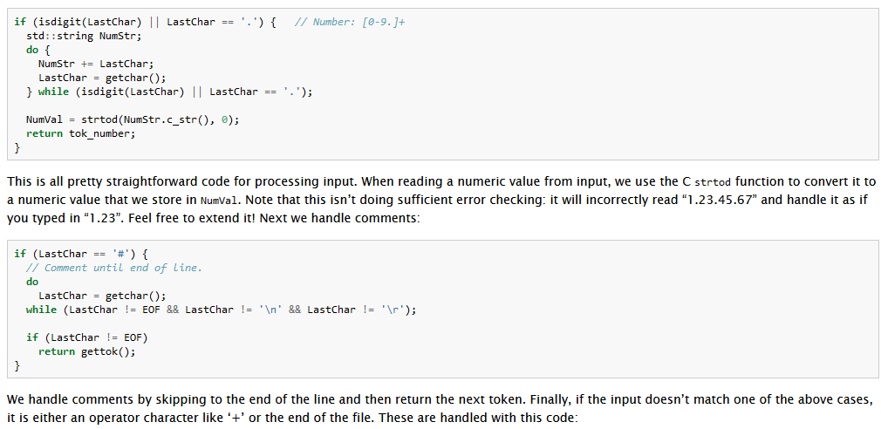
Step 1: The Lexer/Scanner
https://llvm.org/docs/tutorial/MyFirstLanguageFrontend/LangImpl01.html#the-lexer
COMP 520: Compilers – S. Ali

Slide 44
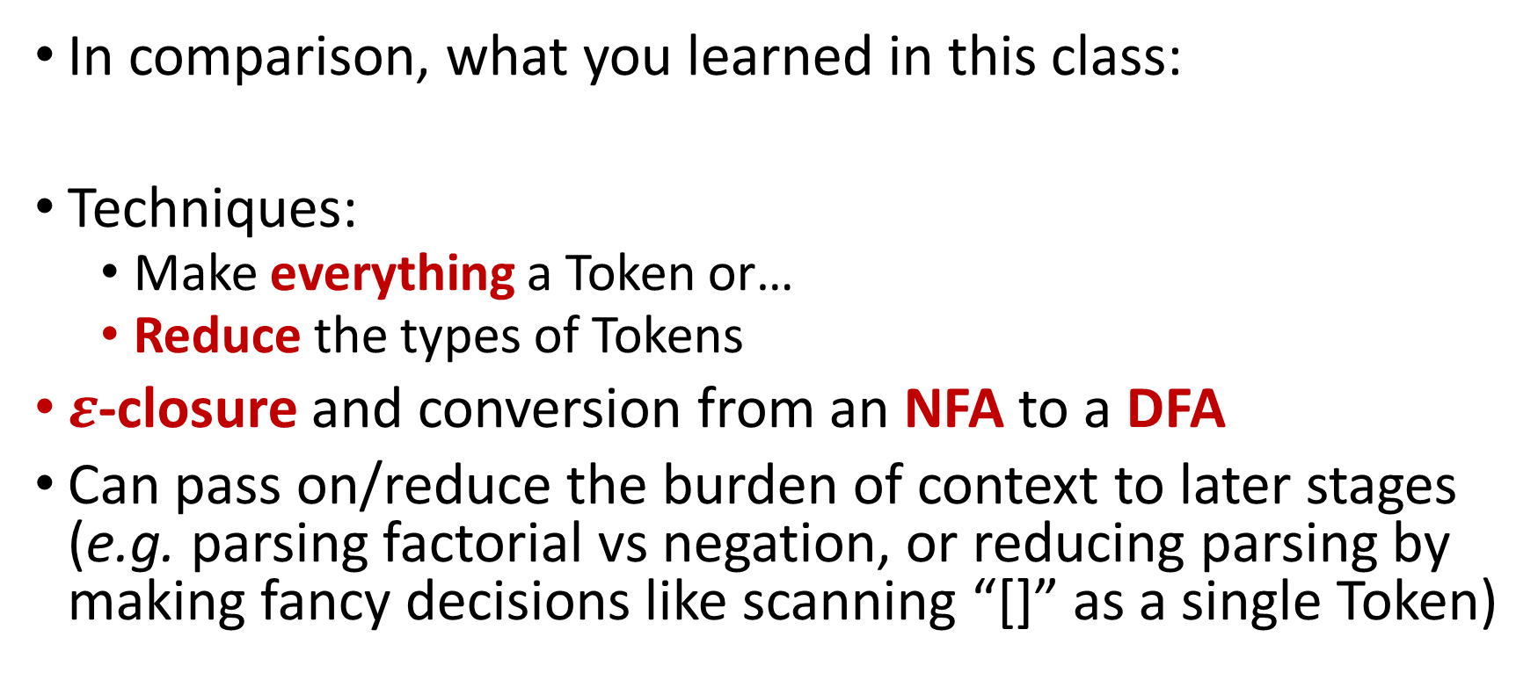
Step 1: The Lexer/Scanner - miniJava
In comparison, what you learned in this class:
Techniques:
  Make everything a Token or…
  Reduce the types of Tokens
$ε$-closure and conversion from an NFA to a DFA
Can pass on/reduce the burden of context to later stages (e.g. parsing factorial vs negation, or reducing parsing by making fancy decisions like scanning “[]” as a single Token)
COMP 520: Compilers – S. Ali

Slide 45
Step 2 – Implementing a Parser and AST
https://llvm.org/docs/tutorial/MyFirstLanguageFrontend/LangImpl02.html
An AST contains the constructs of the input language.
Should closely model the language
COMP 520: Compilers – S. Ali

Slide 46
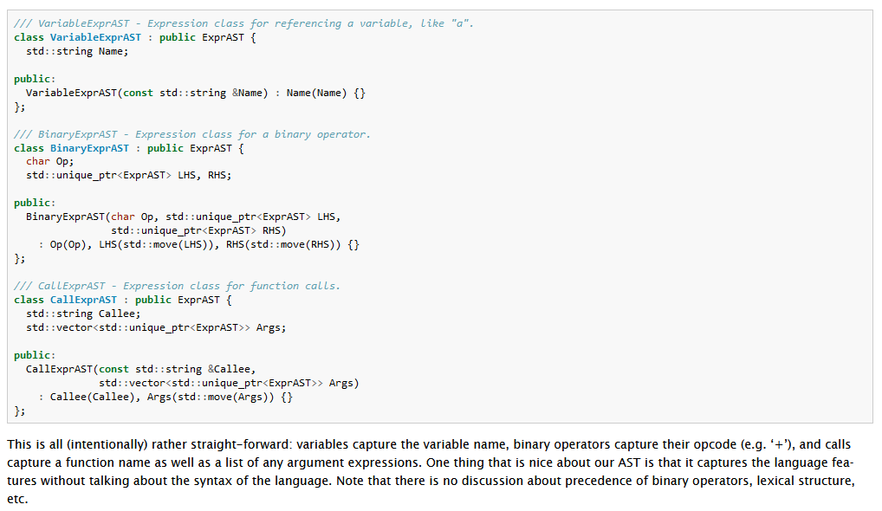
Step 2 – Implementing a Parser and AST
https://llvm.org/docs/tutorial/MyFirstLanguageFrontend/LangImpl02.html
COMP 520: Compilers – S. Ali

Slide 47
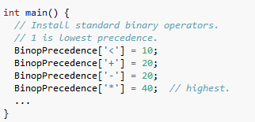
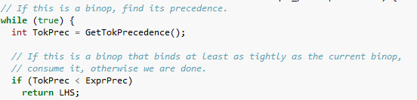
Precedence in LLVM
Need to only specify precedence:
Assign each Operator token the
relevant precedence value.
Loop through and find highest precedence operations in an Expression, and resolve those first.
COMP 520: Compilers – S. Ali

Slide 48
Step 2 – Parsing and ASTs in miniJava
We learned/discussed Parsing:
  Recursive descent (implemented)
  Shift-Reduce parsing (discussed)
  Push-down automata (you learned this in 455, discussed)
We discussed ASTs:
  Selection of AST grammars should be to achieve
  a separation of concerns
  Stratified grammars can create ASTs with proper precedence constraints easily (never worry about precedence again)
COMP 520: Compilers – S. Ali

Slide 49
LLVM combines PA3 and PA4
https://llvm.org/docs/tutorial/MyFirstLanguageFrontend/LangImpl03.html
In their tutorial for LLVM, only one IDTable (called NamedValues), a very simple language that doesn’t need SI or objects or fields.
In comparison: you learned object oriented contextual analysis, which is significantly harder.
CodeGen is actually done per-AST. Each concrete AST defines a codegen method and generates code that way.
COMP 520: Compilers – S. Ali

Slide 50
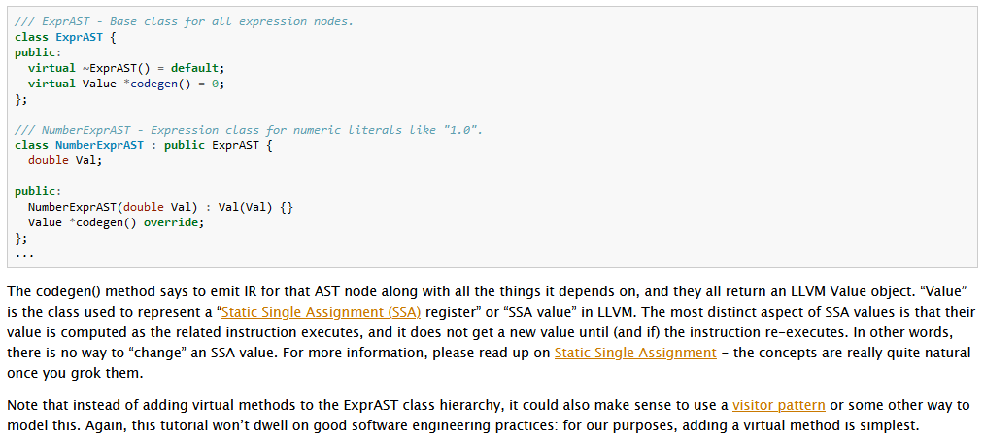
LLVM Traversal: “You should try visitors”
https://llvm.org/docs/tutorial/MyFirstLanguageFrontend/LangImpl03.html
COMP 520: Compilers – S. Ali

Slide 51
LLVM- Front End vs Back End
Front-end deals with parsing (think PA1-PA3)
Back-end deals with code generation
LLVM has prebuild back-end drivers that will generate things like x64 or arm
If you have a custom architecture, will have to do code generation just like you did with PA4.
COMP 520: Compilers – S. Ali

Slide 52
LLVM – Backend programming
Must specify a register set (number of registers)
Must specify register overlap (think RAX/EAX/AX/AL)
Unsurprisingly, would have to do file headers yourself (can’t quite automate that process)
Unlike what we did in class, LLVM requires you to go from the IL to your destination code (instead of from ASTs).
This is easier as IL is similar to assembly.
COMP 520: Compilers – S. Ali

Slide 53
Backend / PA4
What you did in comparison:
  Did the more difficult output to assembly from ASTs
This means you are well equipped to output to an IL then convert from your own IL to real assembly whenever you need to retarget.
COMP 520: Compilers – S. Ali

Slide 54
Backend / PA4 (2)
LLVM backend tutorial: https://llvm.org/docs/WritingAnLLVMBackend.html
Idea: register sets, instruction sets, instruction scheduling, relation mapping, and branch construction.
After that, you create a directed acyclic graph (DAG) as your instruction selector
COMP 520: Compilers – S. Ali

Slide 55
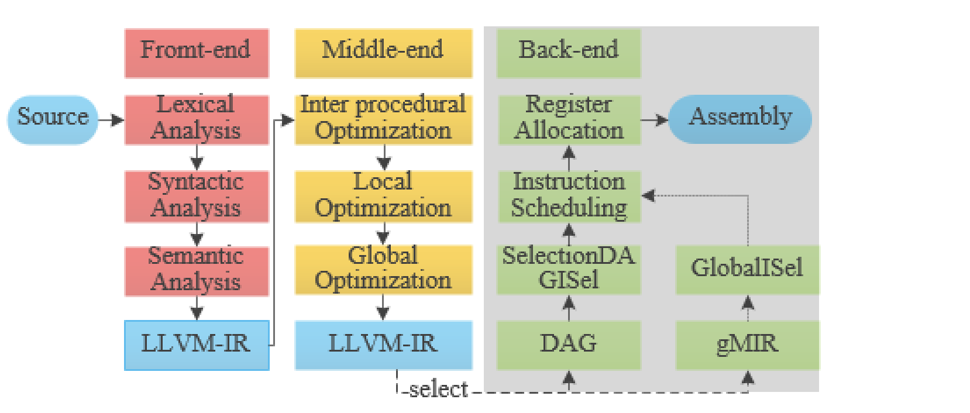
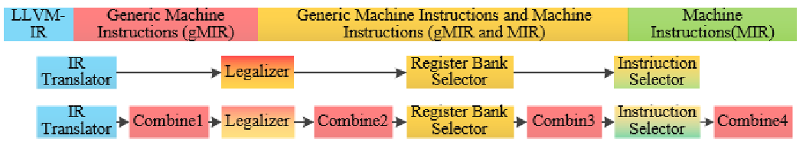
Backend / PA4 (3)
Source: Optimization based on LLVM global instruction selection
Front End
COMP 520: Compilers – S. Ali

Slide 56
Code Generation
Idea: several passes to reach usable code
Similar idea to generating tuple code, then “legalizing” the concept of unlimited registers by reducing register usage, generating spillover code, and changing “extra” registers to memory operations.
Multiple passes needed to achieve usable code.
COMP 520: Compilers – S. Ali

Slide 57
To conclude COMP-520
“Reflections on Trusting Trust” – Ken Thompson
  Idea: how to compile bugs/backdoors in a compiler that can’t be discovered unless you analyze the assembly code
You learned quite a bit more than “how to build a basic compiler that isn’t practical”
Use techniques and theory from this class to build modern and competitive compilers. (Recall MSVS example)
Ideally, you also learned the importance of time management when you have a month to work on a programming project.
COMP 520: Compilers – S. Ali

Slide 58
See you at the final!
5/9 at 4pm
Have a great summer!
COMP 520: Compilers – S. Ali

Slide 59
End

Slide 60
COMP 520: Compilers – S. Ali

Slide 61
COMP 520: Compilers – S. Ali

Slide 62
COMP 520: Compilers – S. Ali

Slide 63
COMP 520: Compilers – S. Ali

